Slide 1
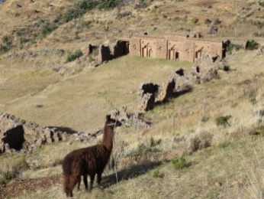
Master of Arts in
Anthropology
The Anthropology Department at the University of North Carolina at Charlotte offers a two year program of study leading to a Master of Arts degree in either general or applied Anthropology. Our department specializes in:
Gender and Culture
Environmental and Urban Anthropology
Ritual and Religion
Politics of Language and Exchange
Anthropology of Food
Bioarchaeology
Applied Anthropology
Archaeology of Complex Societies
Medical Anthropology
Evolution and Genetics
Global Public Health
Development and Human Rights

Slide 2
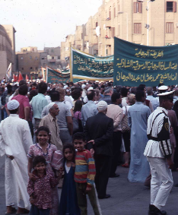
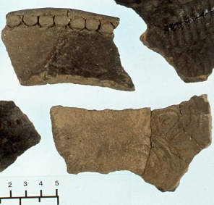
Our MA program prepares students for:
Applied work with in the public and private sectors, with NGOs, non-profits, cultural resource management firms, and a variety of other private companies.
Teaching in Anthropology.
Ph.D. programs in Anthropology and related fields (Geography, History, Religious Studies, Area Studies)
Fall 2018 Application deadline for priority funding:
March 1, 2018
For More Information:
Department of Anthropology
University of North Carolina at Charlotte
Barnard 225
9201 University City Boulevard
Charlotte, NC 28223-0001
tel (704) 687-5090
Prof. Nicole Peterson
Director of Graduate Studies
704-687-5094 anth-grad@uncc.edu
Department website:
http://anthropology.uncc.edu/

