Slide 1
Politics, Power, Genres and Gender on the Hill
and how linguistic anthropology can help us arrive at an evidence-based perspective

Slide 2
What is speech genre?
Speech genre is a speech style oriented to the production and reception of a particular kind of text (Briggs and Bauman, 1992)

Slide 3
Genre: What exactly is the nature of senate hearings? Job interview or trial?
The nature of the hearings, per Washington Post article:
https://www.washingtonpost.com/outlook/kavanaughs-senate-hearing-isnt-a-trial-the-standard-isnt-reasonable-doubt/2018/09/20/1eb1ee34-bd15-11e8-b7d2-0773aa1e33da_story.html?noredirect=on&utm_term=.eb2775a75824
The hiring of sex crimes prosecutor:
https://www.cnn.com/2018/09/24/politics/christine-blasey-ford-brett-kavanaugh-outside-prosecutor-hearing/index.html

Slide 4
Genre: How does it matter?

Slide 5
. Who will decide? Who are the people on the Senate Hearing Committee:
What can we assume about their position on violence against women? In 2013, six members of the committee voted against the reauthorization of the Violence against Women Act:
Chuck Grassley
Orin Hatch
Mike Lee
Lindsay Graham
John Cornyn
Ted Cruz

Slide 6
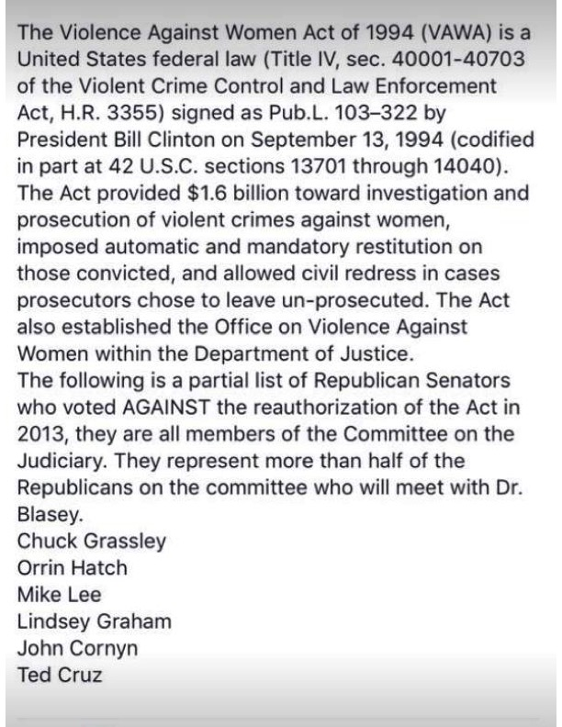

Slide 7
Do any of the senators on the hearing committee have a track record of participating in similar events?
Three senators to participate in the Ford hearings were in 1991 Anita Hill-Clarence Thomas hearings.
https://www.cnn.com/2018/09/22/politics/senate-judiciary-committee-chuck-grassley-patrick-leahy-orrin-hatch/index.html

Slide 8
The complainant
Why has Christine Blasey Ford not reported the incident to the police or her parents, when it happened? NYT columnist’s perspective, based on his own experience:
https://www.facebook.com/CuomoPrimeTime/videos/2265989087017887/UzpfSTY2Nzk4Mjk4MToxMDE1NjE2MzI0MzA5Nzk4Mg/ NYT columnist, Charles Blow

Slide 9
The complainant
Why Christine Blasey Ford may not be able to recall many of the details? Patti (Reagan) Davies experience:
https://thehill.com/blogs/blog-briefing-room/news/407851-ronald-reagans-daughter-defends-kavanaugh-accuser-i-was

Slide 11
A déjà vu all over again? Politics, Power, and Gender on the Hill.
Why many are concerned about a possible bias in the hearings?
We’ve been there before: Hill-Thomas 1991 hearings
http://www.youtube.com/watch?v=XfvDcMzyAlY
http://www.youtube.com/watch?v=egTyaIAaqz8

Slide 12
How to move beyond (mere) impressions in identifying discrimination and bias in discourse
Norma Mendoza Denton’s “Pregnant Pauses” (1995). Positionality, intersectionality, and CA markers of bullying and bias in Hill-Thomas transcripts.

