Slide 1
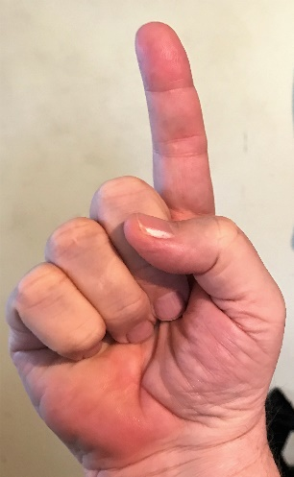
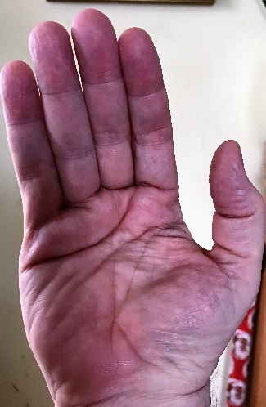
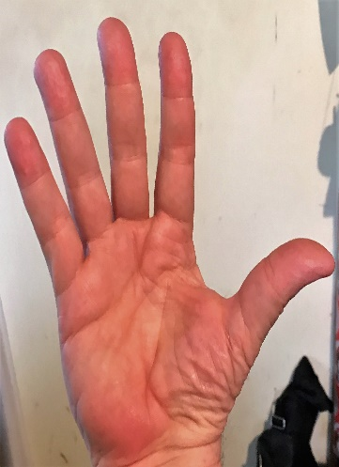
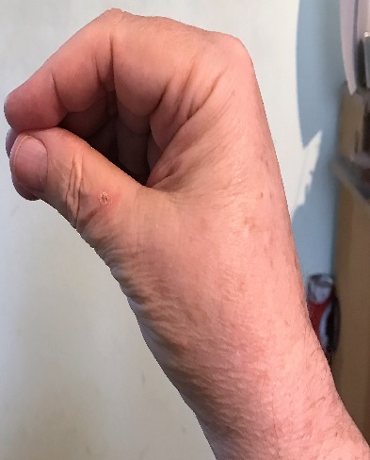
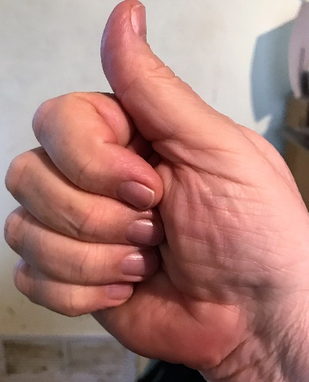
Power of Five – INTRO 1 – with SW
POWER OF FIVE USES FIVE HAND SHAPES
LEFT HAND
Write each shape five times.

Slide 2
Power of Five – INTRO 2 – with SW
POWER OF FIVE USES FIVE HAND SHAPES
RIGHT HAND
Write each shape five times.

Slide 3
Power of Five – L1 – S1 – wSW
FIVE
All five fingers of the hand are spread out and shown palm away from the signer.
https://youtu.be/LKFwLuyK08c
LEFT HAND (note thumb on right)
(Sign this five times)
https://youtu.be/DeCuEJ2scjY
RIGHT HAND (note thumb on left)
(Write these five times)

Slide 4
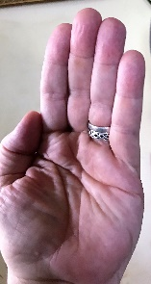
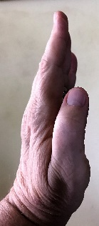
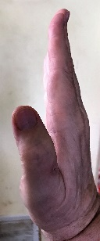
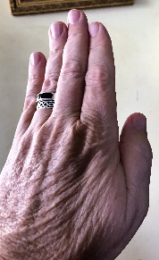
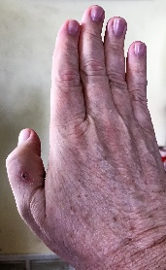
Power of Five – L1 – S1A – wSW
(1) PALM FACING SIGNER
Hands can be rotated through three dimensions. 6 palm facings are shown:
(1) Palm toward the signer
(2)Edge on vertical.
(3) Palm away from the signer (back of hand)
.
(continued next page)
(1) Note the four fingers are shown as an oblong with the thumb sticking out the left or right. Palm is white facing the signer.
(3) PALM AWAY FROM SIGNER
(2) PALM EDGE TOWARD SIGNER (VERTICAL)
(2) The oblong is now black and white, with the black side being the back of the hand. The thumb is attached to the black side.
(2) The oblong is now all black for the back of the hand. Note the thumb follows the black side.
Sign and write each hand 5 times.

Slide 5
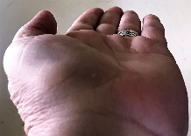
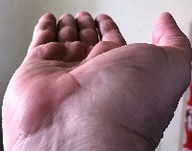
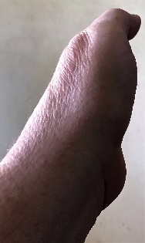
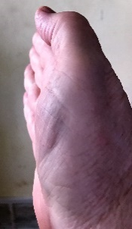
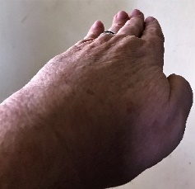
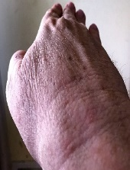
Power of Five – L1 – S1B - wSW
(4) PALM FACE UP
(4) Note the four fingers are shown as an oblong with the thumb sticking out the left or right. There is a space showing that palm is up and away from the signer.
Hands can be rotated through three dimensions. 6 palm facings are shown.
(4) Palm up.
(5) Palm down.
(6) Edge-on horizontal
(5) PALM EDGE ON HORIZONTAL (OUT)
(5 The hands are horizontal pointing away from the signer with a gap for perspective. Back of hand is to the left or the right.
Sign and write each hand 5 times.
(6) PALM FACE DOWN
(6) The hands are face down pointing out. Gap is to show perspective.

Slide 6
Power of Five – L1 – S1C – wSW
Hands can be rotated through three dimensions. Although signers have free motion, for study we show 45 degree rotations.
HAND ROTATIONS
– LEFT HAND
Rotate your left flat hand facing you in each position.
Sign each position five times. Write each position five times.

Slide 7
Power of Five – L1 – S1D - wSW
Hands can be rotated through three dimensions. Although signers have free motion, for study we show 45 degree rotations.
HAND ROTATIONS – RIGHT HAND
Rotate your right flat hand facing you in each position.
Sign each position five times. Write each position five times.

Slide 8
Power of Five – L1 – S2 - wSW
FINE
LEFT HAND
Five-hand edge on thumb touches chest once.
https://youtu.be/aFWRDwN5Q9U
Sign these five times
RIGHT HAND
Write these five times
https://youtu.be/XnB85vNvWFU

Slide 9
Power of Five – L1 – S3 - wSW
POLITE / FANCY
Five-hand edge on, thumb brushes up on chest twice while hand rotates. (Ruffled shirt). (dot in circle means BRUSH)
LEFT HAND
https://youtu.be/oDwsPrwNLHA
(Sign these five times)
RIGHT HAND
https://youtu.be/jtKdEnfYsOc
(Write these five times)

Slide 10
Power of Five – L1 – S4 - wSW
MOTHER
LEFT HAND
5 hand palm facing away from signer. Thumb touches chin twice.
https://youtu.be/24BogUPCWZA
(Sign these five times)
RIGHT HAND
https://youtu.be/BZkZWWSjQDI
Write these five times)

Slide 11
Power of Five – L1 – S5 - wSW
FATHER
LEFT HAND
5-hand facing away from signer. Thumb touches forehead twice.
https://youtu.be/hI1zSwbPWNU
(Sign and write these this five times)
RIGHT HAND
https://youtu.be/GKkv2441-yE

